Slide 1
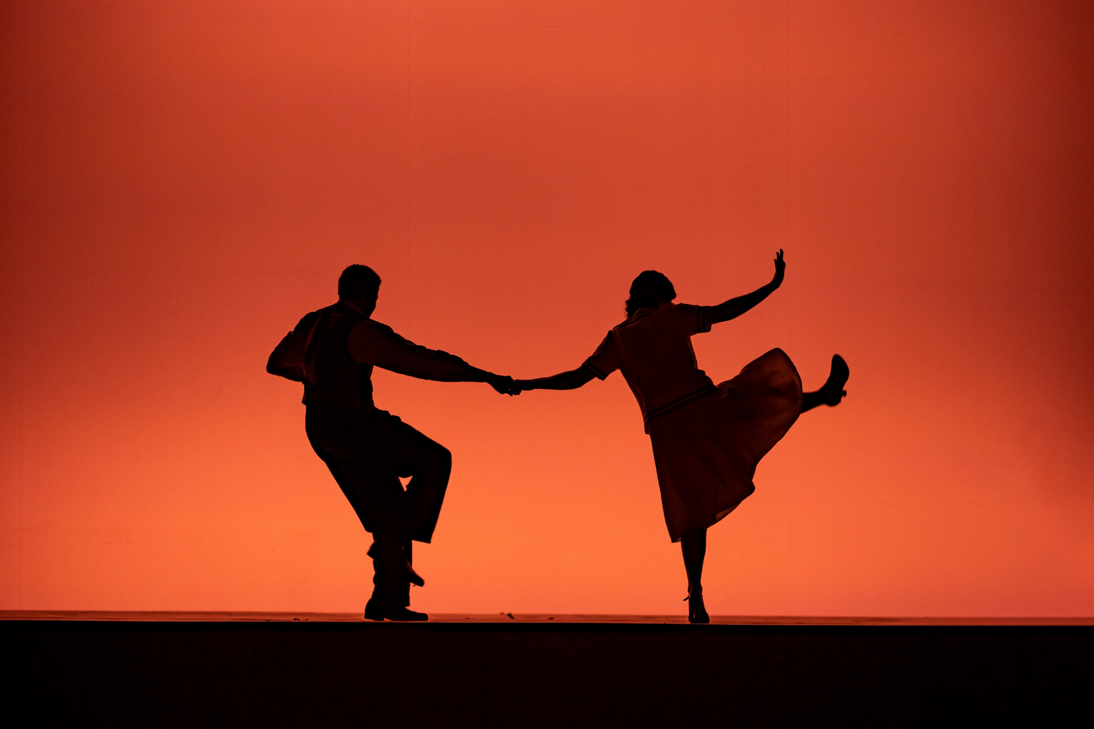
Lighting Programmer
Candidate Pack

Slide 2
Your journey starts here...

Slide 3
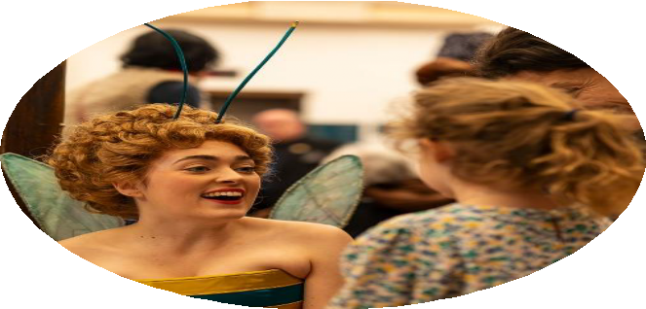
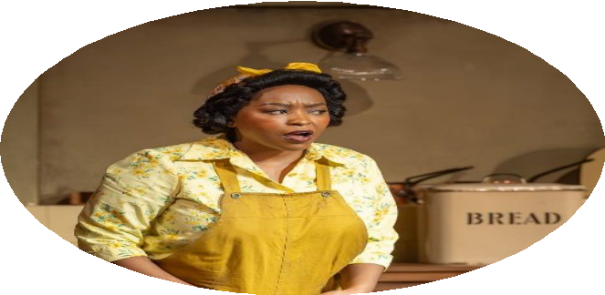
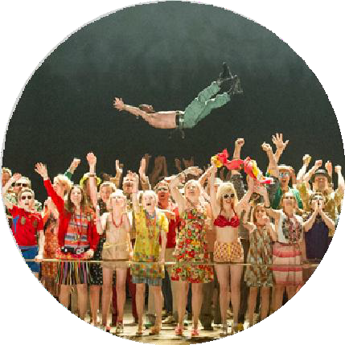
English National Opera Candidate Pack
English National Opera exists for everyone, creating new experiences with opera that inspires, nurtures creativity and makes a difference. Our vision is
for lives changed through opera.
We are a world-class national company recognised internationally for the standard of our work. We nurture talent across the entire company including
a platform for young singers to start and then develop global careers.
We work with a wide range of visiting companies to generate essential revenue and welcome new audiences to share the experience of our theatre.
We take a fresh inspiring approach to opera to reflect the diversity of our culture.
English National Opera is founded on the belief that opera of the highest quality should be accessible
to anyone.
We connect to audiences through inspiring, accessible, world-class opera and stimulating, creative participation programmes.
Aboutus
We believe that opera is a living art form able to connect to people from all parts of our society. We collaborate with a range of artists and art forms as part of our commitment to the future of the art form. We sing in English, as we believe
it enhances the emotional connection between performers and audiences.
We create our productions for the widest possible audiences and aim to introduce completely new audiences to the magic of opera whether at the London Coliseum, outside of our theatrical home or internationally.
We encourage creativity throughout the company and our commitment to the future of opera provides a platform to develop outstanding careers.
We make our productions accessible by offering a large proportion of tickets at affordable prices, and through our attendance schemes.

Slide 4
Lighting Programmer
English National Opera Candidate Pack
SUMMARY
The Lighting Programmer is a key member of English National Opera’s Lighting Department, supporting visiting lighting designers by delivering creative and technical lighting services to the highest standards. The role requires professionalism, strong collaboration, and an understanding of both the artistic and practical needs of productions.
Working closely with visiting Lighting Designers, the post holder will programme and realise lighting designs for ENO productions at the London Coliseum and other venues. They will also oversee the integration of visiting companies’ lighting control systems with ENO’s infrastructure, ensuring seamless operation during touring engagements.
Contract
Fixed term contract, 26/10/2026-21/03/2027
Reports to
Head of Lighting
Salary
£882.79 per week
Location
London Coliseum & other locations as required
Hours
43 hours per week averaged weekly
Therole

Slide 5
Lighting Programmer
English National Opera Candidate Pack
Key Responsibilities
Develop a comprehensive understanding of the London Coliseum’s lighting system, including the control desk, network systems, dimmers, and the integration of visiting control and network equipment.
Work closely with and remain sensitive to the wishes of the lighting designers to achieve the desired aims.
Translate the lighting designer’s artistic vision, offering creative solutions and to deliver results with speed and accuracy.
Prepare show files and paperwork and work closely with the Lighting Supervisors to ensure all controls aspects of a show have been planned and recorded.
Generate and update paperwork to provide accurate and accessible records of shows and their requirements to ensure smooth changeovers and operation of all shows in the ENO repertoire.
Building and facilitating focus notes using Moving Light Assistant (or similar software) for intelligent fixtures.
Devise and communicate methods of data distribution throughout the performance space to the rest of the Lighting department.
Conduct daily checks of the lighting system and carry out fault finding investigations, documenting and reporting any issues.
Work closely with the Lighting personnel when identifying problems and arriving at solutions.
Integrating and achieving the running requirements of the Rep and consulting with colleagues to ensure production deadlines are met to the highest technical standard.
Actively participate in the administration and maintenance of the lighting control network, including performance of the dimmers and the dimmer feedback system (TT Manager), maintenance and administration of Luminex Gateways.
Take an active part in research and development activities relating to control platforms, contributing to internal and public forums and liaising with manufacturers.
Keep a running dialogue with the research and development departments of suppliers to ensure our input into developments and software upgrades.
Ensuring that all activities are carried out in accordance with the ENO’s Health and Safety Policy.
Therole

Slide 6
Lighting Programmer
English National Opera Candidate Pack
Person Specification
Required:
An established background in the core skills relevant to this position including extensive experience of high-level programming of shows on an ETC Apex, quickly and accurately, in a repertory environment.
Understanding of the particular needs of the Repertory environment and programme accordingly
Knowledge of operating and programming other common lighting control systems – MA, Hog etc.
Thorough understanding of Lighting System protocols – DMX512-A, sACN, Art-Net, RDM MIDI Timecode etc.
Excellent knowledge of data networks and dimmer management systems.
Ability to carry out fault-finding assessments of the control and dimming systems and advising on plan of action following diagnosis.
Ability to complete tasks to deadline with minimal supervision
Ability to rig lighting elements appropriately
Familiarity with both current and legacy lighting accessories, including scrollers, low voltage equipment, shutter units, LED drivers.
Confidence in working safely at height
Technical proficiency, a positive and professional attitude, and a ‘hands on’ approach to the job.
Therole

Slide 7




English National Opera Candidate Pack
At the ENO, our people play a vital role in helping us create extraordinary encounters with opera and beyond, so it’s just as important that we reward people beyond their salary to recognise their contributions.
Your Wellbeing
Annual Leave: 25 days plus Public Holidays
Hybrid and flexible working
Eye care vouchers
Enhanced Company Sick Pay
Enhanced Family Friendly Leave (including Maternity Leave and Paternity Leave)
Cycle-to-Work Scheme
Employee Assistance Programme (EAP) through Spectrum.Life:
  Confidential support available 24/7, 365 days a year for employees
  Virtual GP & digital physio
  Wellbeing portal including videos, podcasts, and factsheets on topics such as sleep, diet and exercise
Seeing Our Performances
Complimentary tickets for ENO and selected London Coliseum performances
Staff rate for ENO performances
Complimentary tickets to talks, recitals and behind-the-scenes events
Encore Extras
Managing Money
Salary Sacrifice pension scheme with Natwest Cushon
Interest-free travel season ticket loans
Annual pay review
Discounts across various categories including: Travel, Wellness and Fitness, Electronics, Accessories, Food & Drink and many more through Pebble
Your Professional Development
Annual Professional Development Review to support your personal and career ambitions and achievements
Opportunities for Sabbatical leave to invest in your learning, wellbeing and career goals
“The variety of what we do is amazing, from drinks receptions and garden parties, to opportunities to see performances from Stage, Prompt or the Flys - every day is different and exciting!”
Please note that some of these extras vary depending on contract type or duration.

Slide 8

English National Opera Candidate Pack
Lighting Programmer
To Apply
You can apply for this role on our careers site.
We’ll ask you for:
A copy of your CV
A cover letter
Due to the high volume of applications we receive, we are only available to provide individual feedback to those candidates who reach the interview stage.
Applications
Application Deadline
5pm, Sunday 11 October 2026
Interviews
15 & 16 September 2026
We’re proud to be a Disability Confident Employer. If you’d like to apply through the Disability Confident Guaranteed Interview Scheme or require any reasonable adjustments for the application process, please email workwithus@eno.org

Slide 9
English National Opera Candidate Pack
Backstage Secrets to Success
Read the job description carefully
The job description is your score and every note counts. This will help you understand whether the role is a good fit and what is required, so you can tailor your application effectively.
Read the application requirements carefully
Before your first act make sure you know your cues and stage directions. Check for any word limits, additional tasks, or submission deadlines.
Tailor your cover letter
Your cover letter is your aria- your chance to shine. Use this to tell us things that we can’t see on your CV for example: why you want to work with us, how our values align with yours, and any transferable skills that make you a great fit for the role.
Check your application
Before submitting, review spelling and grammar, ensure attachments are included and correctly named, and double-check that your contact details are accurate and up to date. This is not a rehearsal. We repeat, this is not a rehearsal!
Prepare for your interview
Research the organisation, be ready to discuss experience mentioned on your CV, and think about questions you’d like to ask us. See the interview as a duet where each voice is equally as important.
Use AI tools mindfully
AI is a brilliant tool that’s transforming how we work however, please ensure your application is honest and a true reflection of your experience. You can use AI to check grammar and spelling, improve structure and formatting, research the organisation or rehearse mock interviews but remember when the curtain rises, we want to see the real you in the spotlight.
Online interviews
If your interview is online, have a technical rehearsal. Check that the link works beforehand and make sure you have a quiet space, a good internet connection with minimal distractions.
In-person interviews
Confirm who you’ll be meeting on the day, check your route in advance, and leave plenty of time in case of travel disruptions. This is your 5-minute call, you have 5 minutes.
Accessibility
We are an inclusive employer and want to ensure that our process is as accessible as possible. If you have any access requirements, please let us know as soon as possible by emailing us on workwithus@eno.org so that we can ensure that the stage is ready for your performance.
Applications

Slide 10
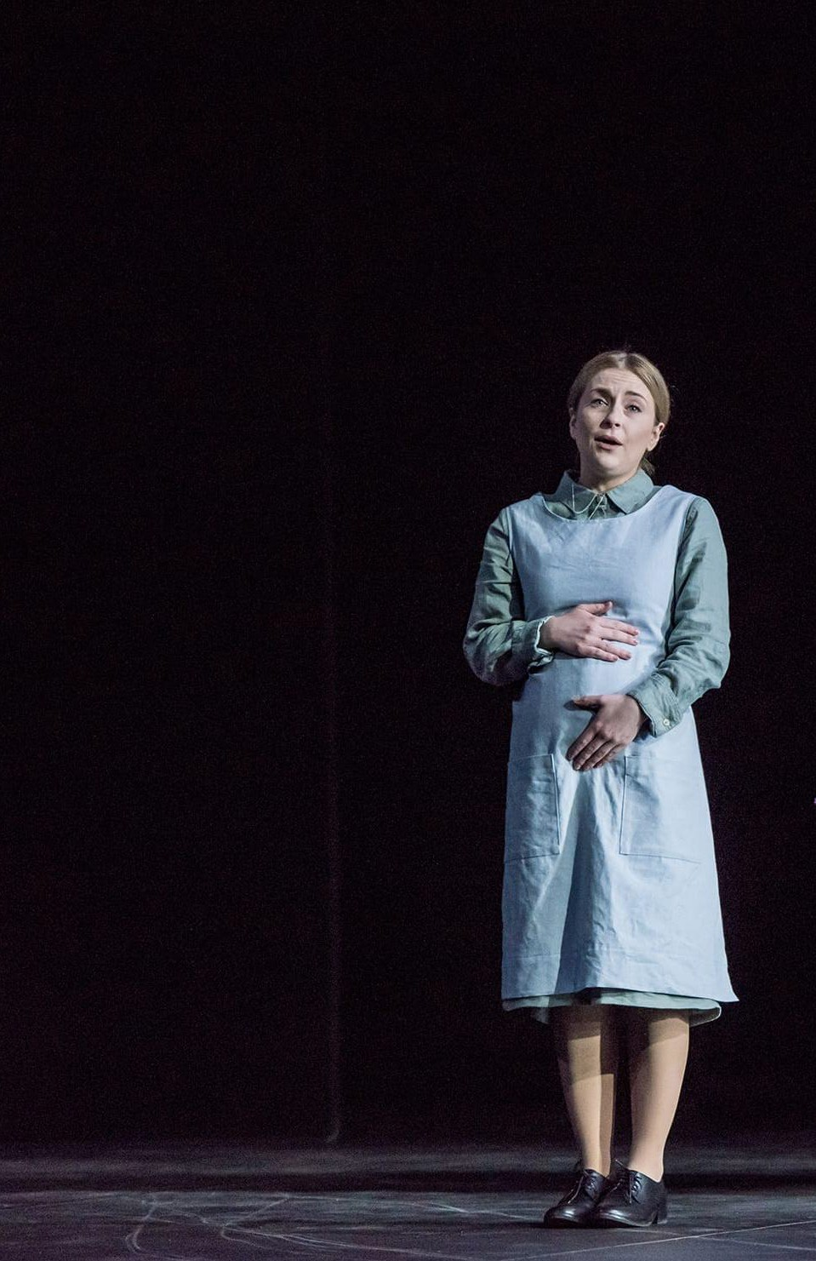
English National Opera Candidate Pack
Confidentiality
Confidentiality is so important in this role and our policy is strict. All information concerning staff, patrons and other ENO business, the disclosure of which could be detrimental to the company, must be held in the strictest confidence and may not be divulged to any unauthorised person at any time.
Equal Opportunities
Equal Opportunities is a given. We will expect the postholder to abide by ENO’s policies on Equal Opportunities and Dignity at Work.
Code of Conduct
Code of Conduct is sometimes assumed, but at ENO we will require the postholder to act in accordance with ENO’s Code
of Conduct whereby everyone shall be treated in a professional and courteous manner with full regard to the avoidance of discrimination, consistent with
current equal opportunities employment
legislation.
Data Protection
Data Protection and adherence to GDPR is equally important. We therefore require that computer information should only be accessed if this has been authorised and is necessary as part of the postholder’s work. You will need to be aware of the GDPR 8 key principals, and the Computer Misuse Act1990.
Information
Health and Safety
Health and Safety is so important at ENO and we would expect that the postholder will be happy to undertake personal responsibility for safety as will be outlined in the ENO safety policy and the Health and Safety at Work Act 1974.

Slide 11
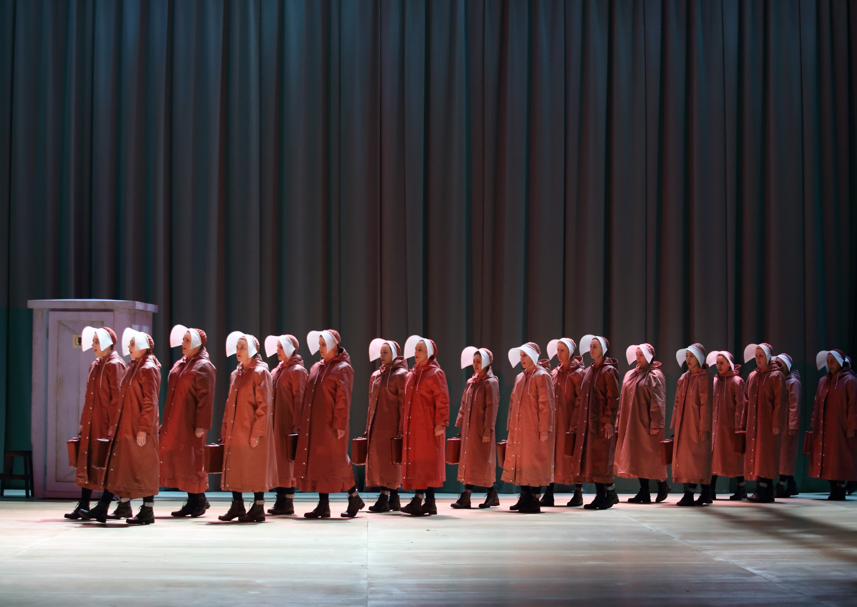

English National Opera is a charitable company limited by guarantee incorporated in England and Wales (Company number 00426792). Charity Registered Number 257210
ENO’s The Handmaid’s Tale 2022. Photography by Catherine Ashmore.

