Slide 1
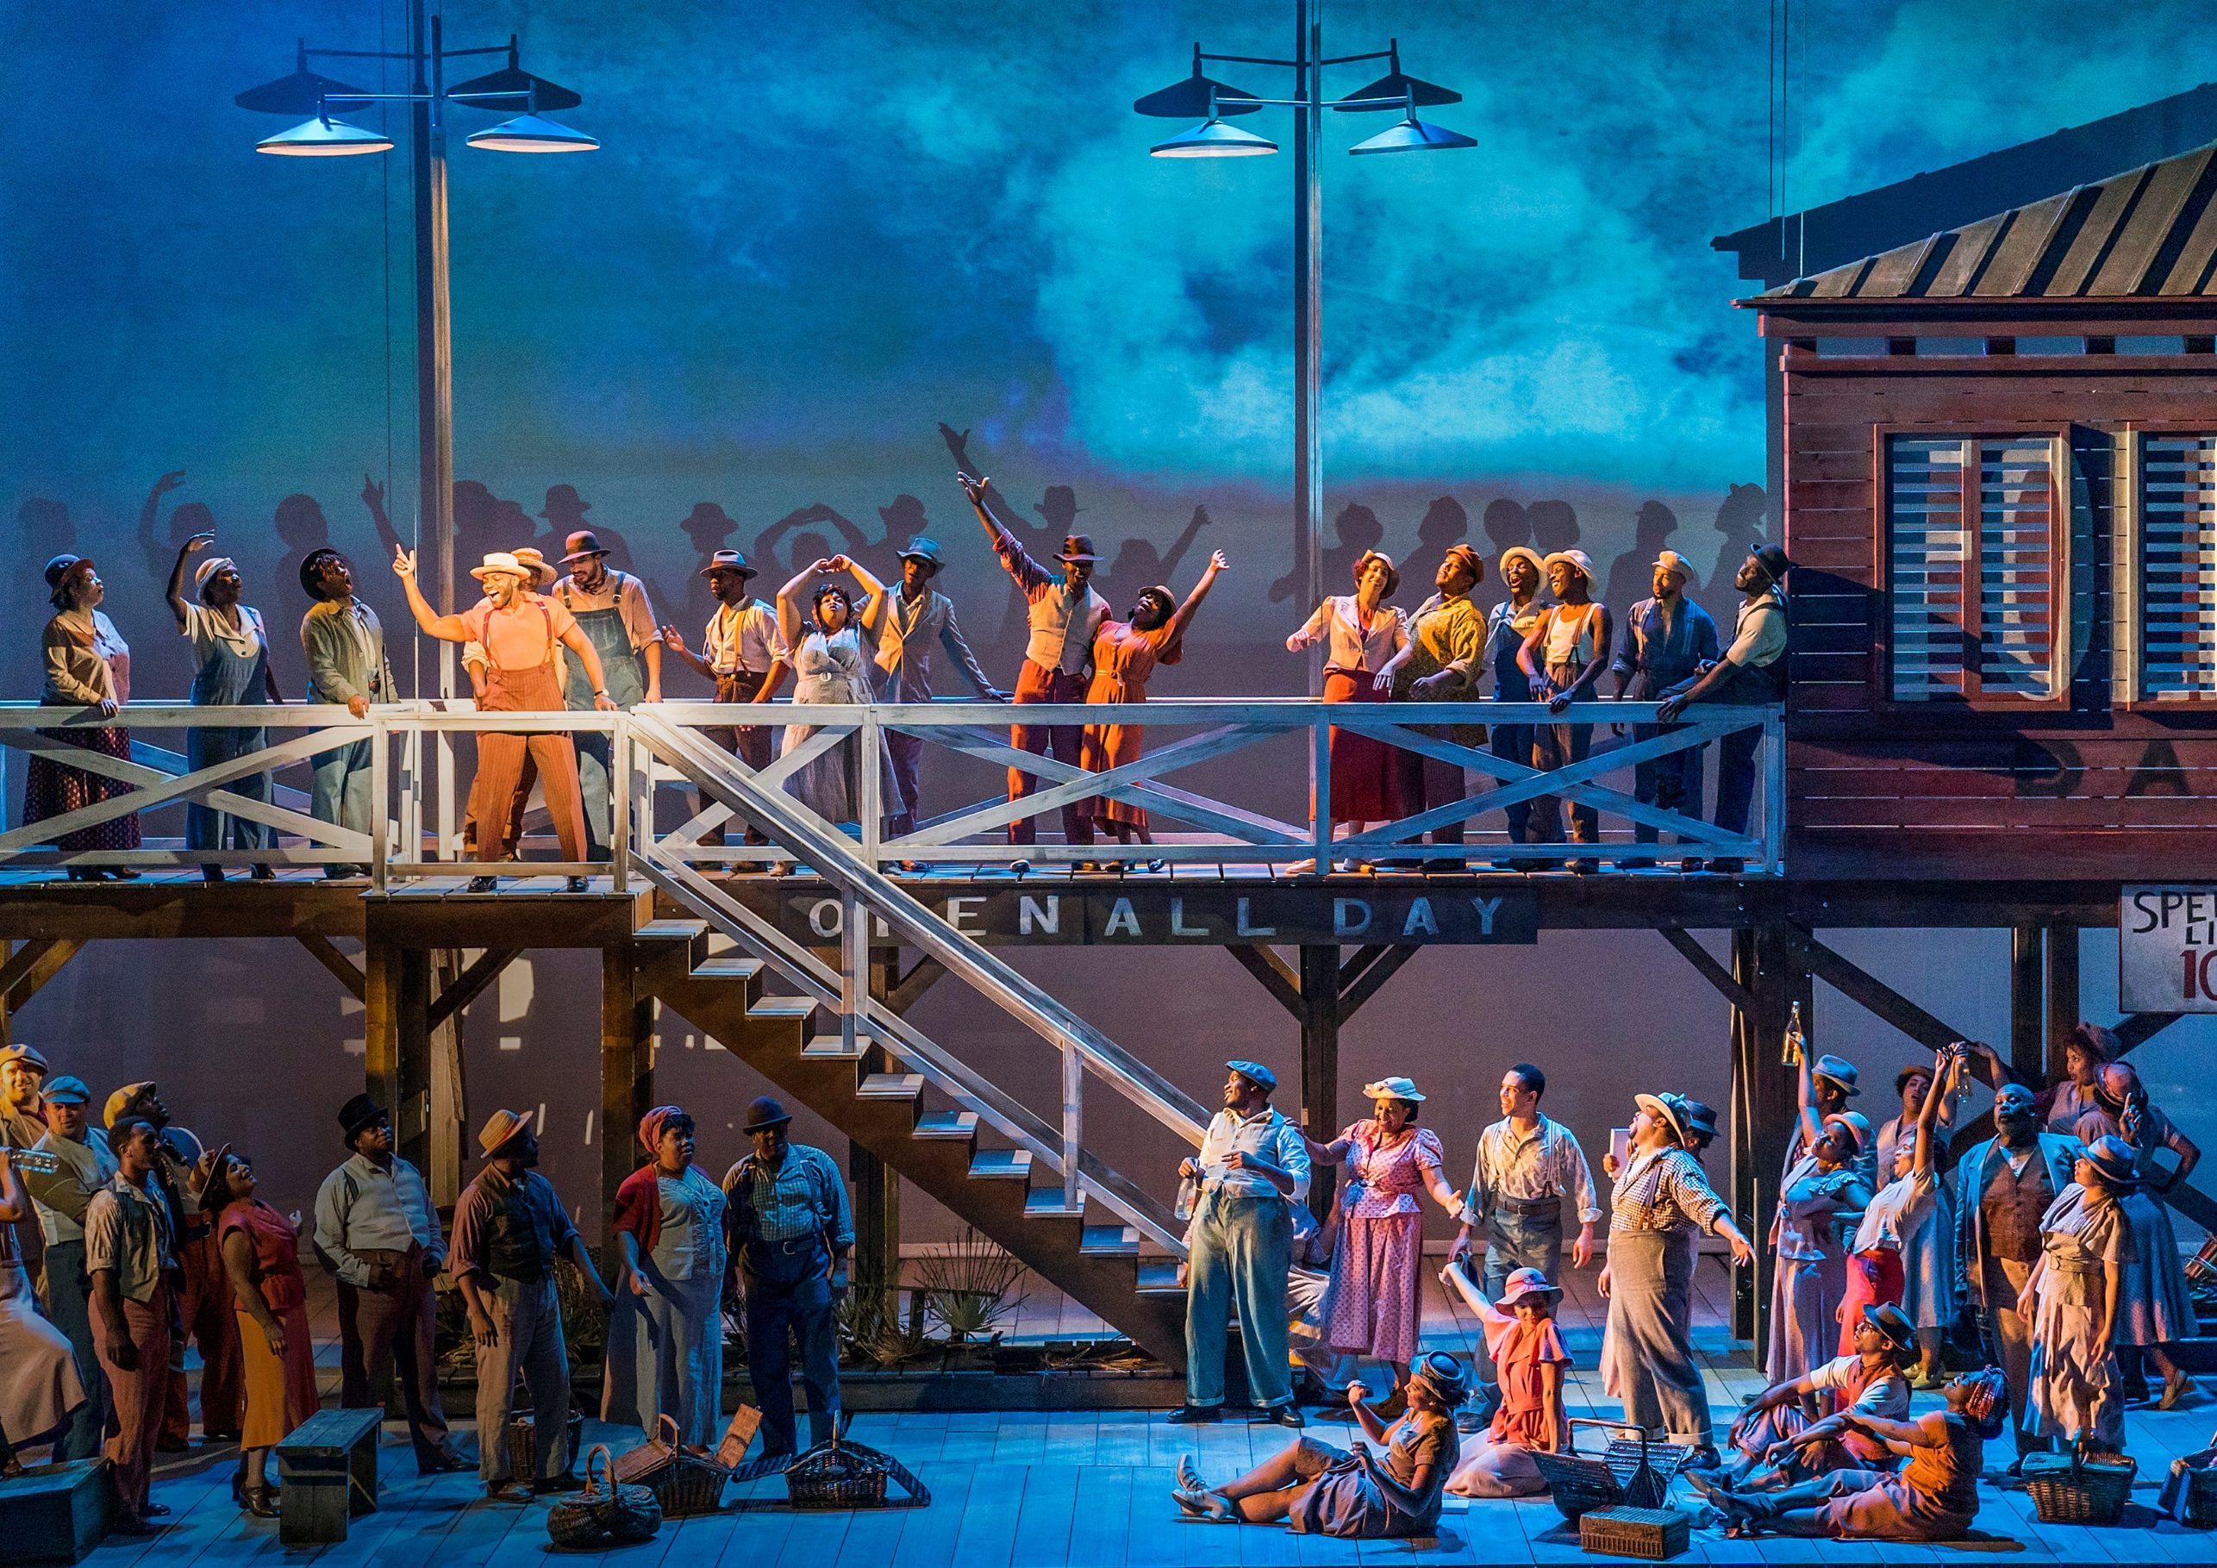
English National Opera
MUSIC DEPARTMENT ADMINISTRATOR
Candidate Pack

Slide 2
Your journey starts here...

Slide 3


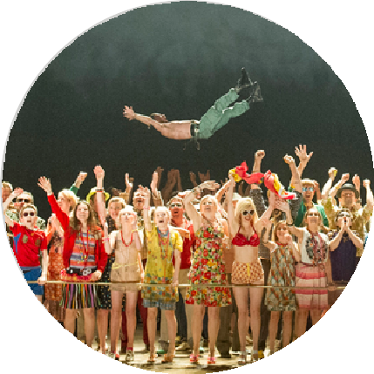
English National Opera Candidate Pack
5
English National Opera exists for everyone, creating new experiences with opera that inspires, nurtures creativity and makes a difference. Our vision is​ for lives changed through opera. Working across our creative centres in London and Greater Manchester, we take a fresh, inspiring approach to opera that reflects the diversity of our culture.
We believe that opera is a living art form able to connect to people from all parts of our society. We collaborate with a range of artists and art forms as part of our commitment to the future of the art form. We sing in English, as we believe​ it enhances the emotional connection between performers and audiences.
We encourage creativity throughout the company. Across London and Greater Manchester, we develop new artistic ideas, commission and create ambitious new work, nurture talent and help shape the future of opera.
We are a world-class national company recognised internationally for the standard of our work, with creative centres in London and Greater Manchester. ​
We nurture talent at every stage of the creative journey, supporting artists, creative practitioners, young singers and future creative professionals to develop and build outstanding careers.
We connect people through world-class opera alongside ambitious learning, participation, creative health, artist development and skills programmes that enrich lives and strengthen communities.
We create our productions for the widest possible audiences and aim to introduce completely new audiences to the magic of opera whether at the London Coliseum, across Greater Manchester, throughout the UK and internationally.
Across both creative centres, we create productions and creative experiences for the widest possible audiences, introducing new audiences to the magic of opera at the London Coliseum, across Greater Manchester, throughout the UK and internationally..
We work with a wide range of visiting companies to generate essential revenue and welcome new audiences to share the experience of our theatre.
About us

Slide 4
English National Opera Candidate Pack
6
Music Department Administrator
English National Opera is founded on the belief that opera of the highest quality should be accessible to everyone and was set up to be for everyone.
It is for this reason that we stage opera of the highest quality always sung in English. It is why we have ticket prices which are affordable, or free, if you’re under 18. It Is why we work with local communities to bring opera to people who might otherwise not experience it.
We are looking for a Music Department Administrator, who will be responsible for providing effective administrative support for Music Department. This is a pivotal role within the company that requires excellent communication and administration skills liaising across the Music Department and the rest of the company.
This appointment will be made on merit, but we believe that diversity strengthens and enriches us, and that it is the responsibility of everyone at ENO to make the arts and cultural sector a more diverse and equal place. As Black, Asian and minority ethnic (BAME) and disabled people are currently under-represented at ENO, we particularly encourage and welcome applications from BAME and disabled applicants.
Reporting to:
Director, Orchestra and Music Department
Contract
12 Month Fixed Term Contract
Location
London Coliseum and other locations as required
Salary
£28,206
Hours
35 Hours per week
Application Deadline
01 November 2026 – 5pm
The role

Slide 5
Music Department Administrator
English National Opera Candidate Pack
7
SUMMARY
MUSIC DEPARTMENT
The Music Department comprises of the Chorus (36 choristers), Orchestra (53 orchestral players), Music Staff (3 repetiteurs and 1 trainee repetiteur), Chorus Director, Library and Surtitles. The Music Department is led by the Music Director (MD) who is responsible for the development of the Company’s artistic policy in collaboration with the Artistic Director. The Director of the Music Department (DMD) is responsible for the operational management of the department and the Head of Music (HOM) is responsible for the musical management of the department.
PURPOSE OF JOB
Reporting to the DMD, the Music Department Administrator is responsible for providing effective administrative support for the Music Department and Music Director. This is a pivotal role within the company that requires excellent communication and administration skills liaising across the Music Department and the rest of the company, with a desire to maximise the administrative potential for the Music Department.
KEY RESPONSIBILITIES
Diary planning and management for the Music Director, liaising with the agent and supporting the DMD and HOM for key events and commitments. Liaising with the Exec EA’s as necessary.
Supporting the MD for booking travel and accommodation for the Music Director and the wider department as required.
Administratively support the Music Staff Manager in the operation of the Music Staff, including finance payments, NA requests, engagement of freelance music staff as well as Dialect and Dialogue coach and assist with the weekly call sheet scheduling.
Arranging coaching sessions in collaboration with the HOM for singers as necessary.
Manage the booking of all rehearsal room requirements for the Music Department (Chorus, Orchestra and coaching rooms).
KEY RESPONSIBILITIES CONTINUED
Manage all keyboard requirements for the music department including managing the tuning rota and booking piano hires and moves as and when required.
Assist the DMD with administration of Translation commissions, royalty payments and general Music Department external communications.
Facilitating the onboarding process for visiting conductors and assistant conductors, liaising with them as necessary, as well as developing good working relationship with all production teams throughout the production period.
Support the recruitment for the Music Department, to include administrative roles, as well as auditions for Music Staff, Chorus, Orchestra and Charles Mackerras Fellowship.
Reporting to the DMD and relevant Managers, support to coordinate all health and safety requirements for the Music Department, including the Music Staff, ensuring that the Company’s Health and Safety Policies and procedures are fully implemented and relevant safety equipment is implemented.
Responsible for finance processes (expenses, raising Purchase Orders on Dynamics, sales requests) for all payments within the Music Department and maintaining accurate records.
Take accurate minutes of key meetings (Performers LSG, Sound Policy) where required.
Responsible for keeping efficient digital records for the Music Department, to include archive information on past seasons.
Attend rehearsals/performances when required.
Additional support across the Music Department as agreed with the Director of the Music Department.
Any other duties as required.
The role

Slide 6
Music Department Administrator
English National Opera Candidate Pack
7
PERSON SPECIFICATION
Essential:
Educated to degree level or equivalent.
Excellent interpersonal skills ability to act with diplomacy and discretion.
Ability to work well under pressure and prioritise workload.
Excellent organisational and administrative skills, and attention to detail.
Outstanding written and verbal communication skills
Problem solving skills and the ability to use initiative.
Flexible approach to working.
Full competence in Microsoft Office.
A calm, professional manner with a good sense of humour
Desirable:
Relevant experience of working in an arts organisation.
Passion for music.
Knowledge of OPAS.
The role

Slide 7




English National Opera Candidate Pack
At the ENO, our people play a vital role in helping us create extraordinary encounters with opera and beyond, so it’s just as important that we reward people beyond their salary to recognise their contributions.
Your Wellbeing
Annual Leave: 25 days plus Public Holidays
Hybrid and flexible working
Eye care vouchers
Enhanced Company Sick Pay
Enhanced Family Friendly Leave (including Maternity Leave and Paternity Leave)
Cycle-to-Work Scheme
Employee Assistance Programme (EAP) tthrough Pebble:
  Confidential support available 24/7, 365 days a year for employees
  Virtual GP & digital physio
  Wellbeing portal including videos, podcasts, and factsheets on topics such as sleep, diet and exercise
Seeing Our Performances
Complimentary tickets for ENO and selected London Coliseum performances
Staff rate for ENO performances
Complimentary tickets to talks, recitals and behind-the-scenes events
Encore Extras
Managing Money
Salary Sacrifice pension scheme with Natwest Cushon
Interest-free travel season ticket loans
Annual pay review
Discounts across various categories including: Travel, Wellness and Fitness, Electronics, Accessories, Food & Drink and many more through Pebble
Your Professional Development
Annual Professional Development Review to support your personal and career ambitions and achievements
Opportunities for Sabbatical leave to invest in your learning, wellbeing and career goals
“The variety of what we do is amazing, from drinks receptions and garden parties, to opportunities to see performances from Stage, Prompt or the Flys - every day is different and exciting!”
Please note that some of these extras vary depending on contract type or duration.

Slide 8
English National Opera Candidate Pack
Backstage Secrets to Success
Read the job description carefully
The job description is your score and every note counts. This will help you understand whether the role is a good fit and what is required, so you can tailor your application effectively.
Read the application requirements carefully
Before your first act make sure you know your cues and stage directions. Check for any word limits, additional tasks, or submission deadlines.
Tailor your cover letter
Your cover letter is your aria- your chance to shine. Use this to tell us things that we can’t see on your CV for example: why you want to work with us, how our values align with yours, and any transferable skills that make you a great fit for the role.
Check your application
Before submitting, review spelling and grammar, ensure attachments are included and correctly named, and double-check that your contact details are accurate and up to date. This is not a rehearsal. We repeat, this is not a rehearsal!
Prepare for your interview
Research the organisation, be ready to discuss experience mentioned on your CV, and think about questions you’d like to ask us. See the interview as a duet where each voice is equally as important.
Use AI tools mindfully
AI is a brilliant tool that’s transforming how we work however, please ensure your application is honest and a true reflection of your experience. You can use AI to check grammar and spelling, improve structure and formatting, research the organisation or rehearse mock interviews but remember when the curtain rises, we want to see the real you in the spotlight.
Online interviews
If your interview is online, have a technical rehearsal. Check that the link works beforehand and make sure you have a quiet space, a good internet connection with minimal distractions.
In-person interviews
Confirm who you’ll be meeting on the day, check your route in advance, and leave plenty of time in case of travel disruptions. This is your 5-minute call, you have 5 minutes.
Accessibility
We are an inclusive employer and want to ensure that our process is as accessible as possible. If you have any access requirements, please let us know as soon as possible by emailing us on workwithus@eno.org so that we can ensure that the stage is ready for your performance.
Applications

Slide 9
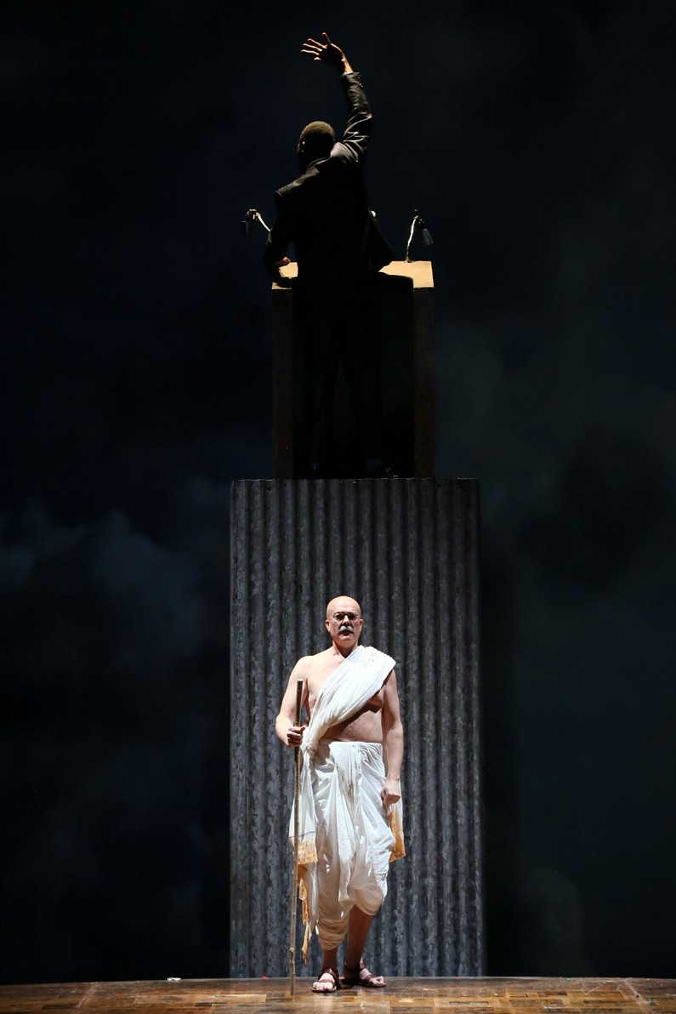
English National Opera Candidate Pack 10
Confidentiality
Confidentiality is so important in this role and our policy is strict. All information concerning staff, patrons and other ENO business, the disclosure of which could be detrimental to the company, must be held in the strictest confidence and may not be divulged to any unauthorised person at any time.
Data Protection
Data Protection and adherence to GDPR is equally important. We therefore require that computer information should only be accessed if this has been authorised and is necessary as part of
the postholder’s work. You will need to be aware of the GDPR 8 key principals, and the Computer Misuse Act 1990.
Health and Safety
Health and Safety is so important at ENO and we would expect that the postholder will be happy to undertake personal responsibility for safety as will be outlined in the ENO safety policy and the Health and Safety at Work Act 1974.
Equal Opportunities
Equal Opportunities is a given. We will expect the postholder to abide by ENO’s policies on Equal Opportunities and Dignity at Work.
Code of Conduct
Code of Conduct is sometimes assumed, but at ENO we will require the postholder to act in accordance with ENO’s Code
of Conduct whereby everyone shall be treated in a professional and courteous manner with full regard to the avoidance of discrimination, consistent with
current equal opportunities employment legislation.
Information

Slide 10
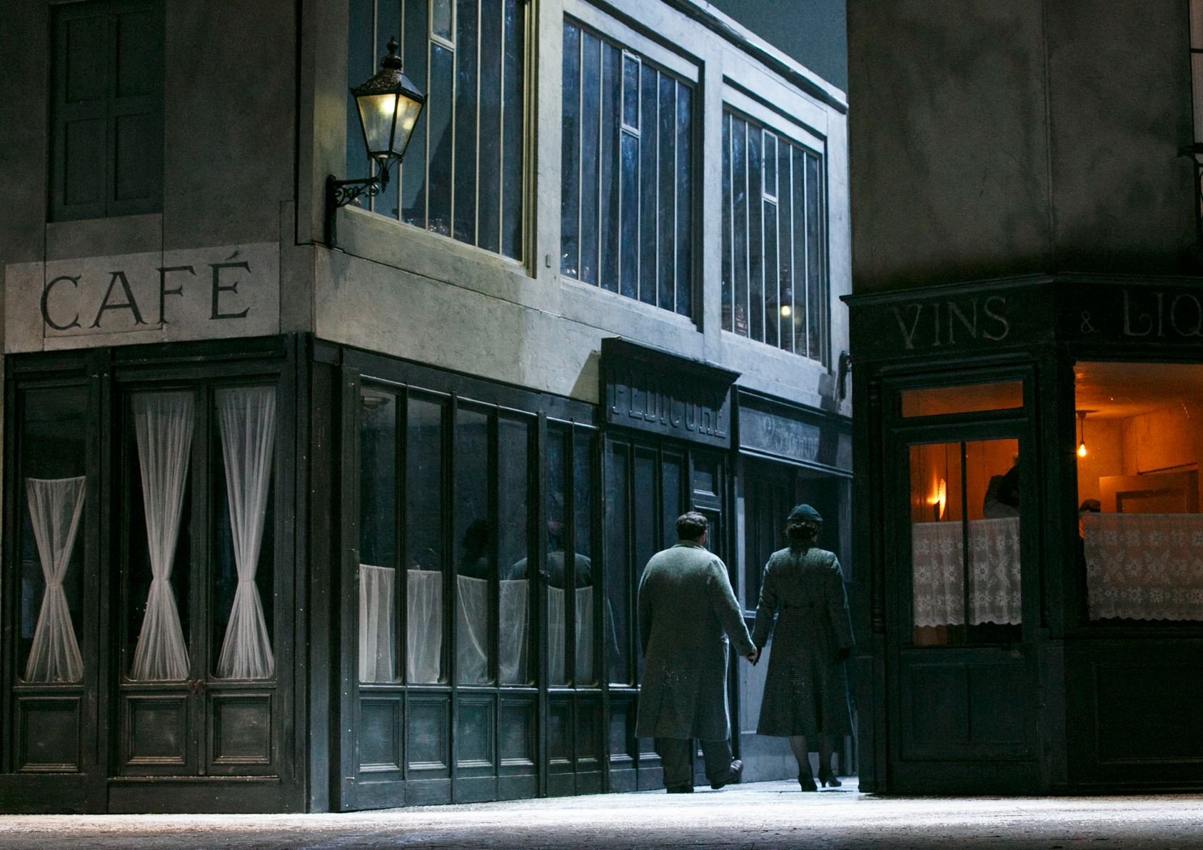

English National Opera is a charitable company limited by guarantee incorporated in England and Wales (Company number 00426792). Charity Registered Number 257210

